Slide 1
CS 326 A: Motion Planning
http://robotics.stanford.edu/~latombe/cs326/2002
Configuration Space –
Basic Path-Planning Methods

Slide 2
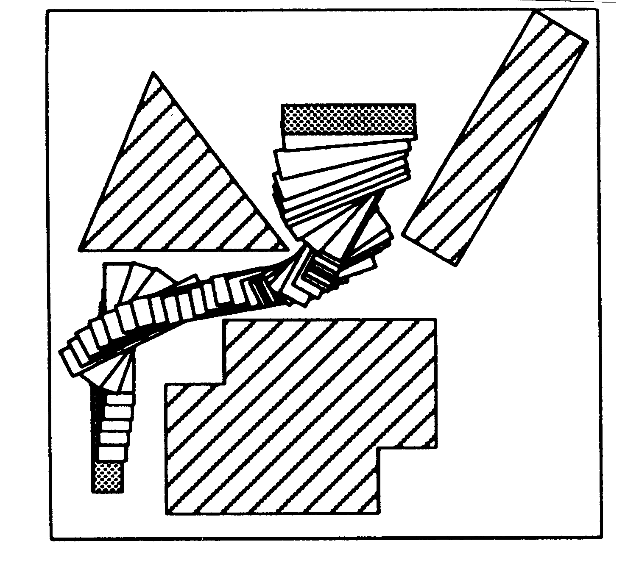
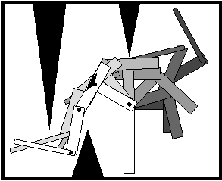
What is a Path?

Slide 3
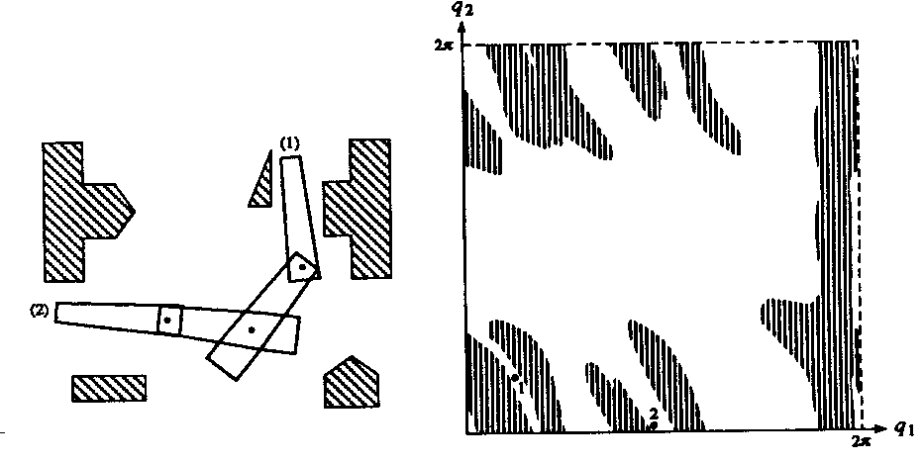
Tool: Configuration Space
(C-Space C)

Slide 4
Configuration Space
q_{n}
q=(q₁,…,q_{n})
q₃
q₁
q₂

Slide 5
Definition
A robot configuration is a specification of the positions of all robot points relative to a fixed coordinate system
Usually a configuration is expressed as a “vector” of position/orientation parameters

Slide 6
Rigid Robot Example
workspace
robot
reference direction
θ
y
reference point
x
3-parameter representation: q = (x,y,θ)
In a 3-D workspace q would be of the form (x,y,z,α,β,γ)

Slide 7
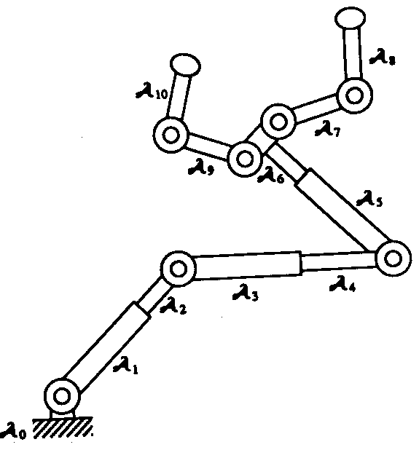
Articulated Robot Example
q = (q₁,q₂,…,q₁₀)
q₂
q₁

Slide 8
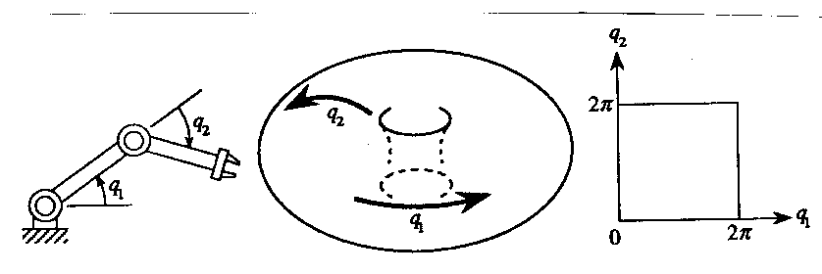
Configuration Space of a Robot
Space of all its possible configurations
But the topology of this space is usually not that of a Cartesian space
C = S¹ x S¹

Slide 9
Configuration Space of a Robot
Space of all its possible configurations
But the topology of this space is usually not that of a Cartesian space
C = S¹ x S¹

Slide 10
Configuration Space of a Robot
Space of all its possible configurations
But the topology of this space is usually not that of a Cartesian space
C = S¹ x S¹

Slide 11
Structure of Configuration Space
It is a manifold
For each point q, there is a 1-to-1 map between a neighborhood of q and a Cartesian space R^{n}, where n is the dimension of C
This map is a local coordinate system called a chart.
C can always be covered by a finite number of charts. Such a set is called an atlas

Slide 12
Example

Slide 13
Case of a Planar Rigid Robot
workspace
robot
reference direction
θ
y
reference point
x
3-parameter representation: q = (x,y,θ) with θ ∈ [0,2π). Two charts are needed
Other representation: q = (x,y,cosθ,sinθ)
→c-space is a 3-D cylinder R² x S¹
embedded in a 4-D space

Slide 14
Rigid Robot in 3-D Workspace
q = (x,y,z,α,β,γ)
Other representation: q = (x,y,z,r₁₁,r₁₂,…,r₃₃) where r₁₁, r₁₂, …, r₃₃ are the elements of rotation matrix R:
r₁₁ r₁₂ r₁₃
r₂₁ r₂₂ r₂₃
r₃₁ r₃₂ r₃₃
with:
  r_{i1}²+r_{i2}²+r_{i3}² = 1
  r_{i1}r_{j1} + r_{i2}r_{2j} + r_{i3}r_{j3} = 0
  det(R) = +1
The c-space is a 6-D space (manifold) embedded
in a 12-D Cartesian space. It is denoted by R³xSO(3)

Slide 15
Parameterization of SO(3)
Euler angles: (φ,θ,ψ)
Unit quaternion:
(cos θ/2, n₁ sin θ/2, n₂ sin θ/2, n₃ sin θ/2)
z
z
z
z
1 → 2 → 3 → 4
ψ
φ
y
θ
y
y
y
x
x
x
x

Slide 16
Metric in Configuration Space
A metric or distance function d in C is a map
d: (q₁,q₂) ∈ C² → d(q₁,q₂) > 0
such that:
  d(q₁,q₂) = 0 if and only if q₁ = q₂
  d(q₁,q₂) = d (q₂,q₁)
  d(q₁,q₂) < d(q₁,q₃) + d(q₃,q₂)

Slide 17
Metric in Configuration Space
Example:
Robot A and point x of A
x(q): location of x in the workspace when A is at configuration q
A distance d in C is defined by:
d(q,q’) = max_{x∈A} ||x(q)-x(q’)||
where ||a - b|| denotes the Euclidean distance between points a and b in the workspace

Slide 18
Specific Examples in R² x S¹
q = (x,y,θ), q’ = (x’,y’,θ’) with θ, θ’ ∈ [0,2π)
α = min{|θ−θ’| , 2π−|θ−θ’|}
d(q,q’) = sqrt[(x-x’)² + (y-y’)² + α²]
d(q,q’) = sqrt[(x-x’)² + (y-y’)² + (αρ)²]
where ρ is the maximal distance between the reference point and a robot point
θ
α
θ’

Slide 19
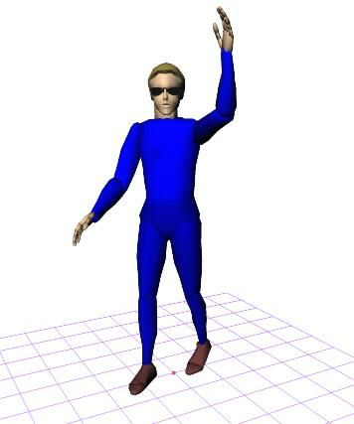
Notion of a Path
q
q
0
1
q
q
2
n
τ(s)
q
q
3
4
A path in C is a piece of continuous curve connecting two configurations q and q’:
τ : s ∈ [0,1] → τ (s) ∈ C
s’ → s ⇒ d(τ(s),τ(s’)) → 0

Slide 20
Other Possible Constraints on Path
q
q
0
1
q
q
2
n
τ(s)
q
q
3
4
Finite length, smoothness, curvature, etc…
A trajectory is a path parameterized by time:
τ : t ∈ [0,T] → τ (t) ∈ C

Slide 21
Obstacles in C-Space
A configuration q is collision-free, or free, if the robot placed at q has null intersection with the obstacles in the workspace
The free space F is the set of free configurations
A C-obstacle is the set of configurations where the robot collides with a given workspace obstacle
A configuration is semi-free if the robot at this configuration touches obstacles without overlap

Slide 22
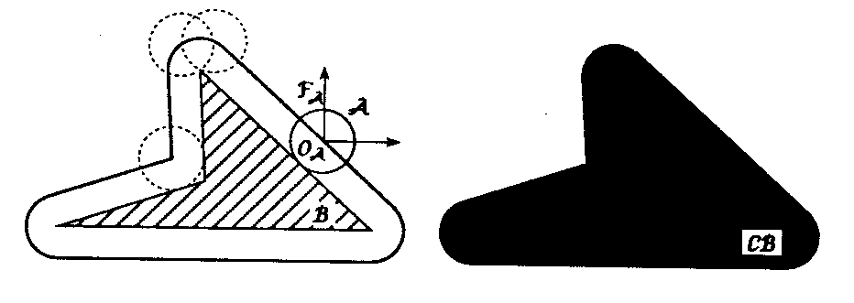
Disc Robot in 2-D Workspace

Slide 23
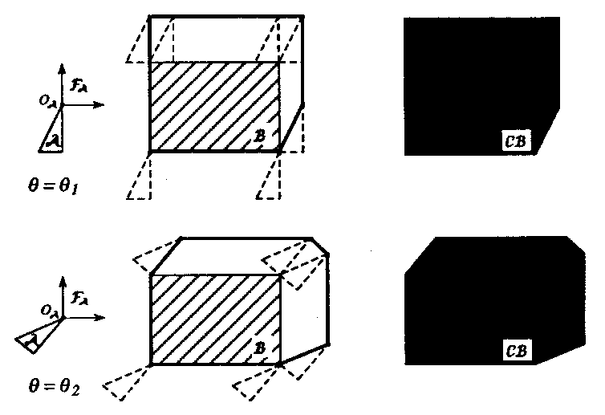
Rigid Robot Translating in 2-D
CB = B A = {b-a | a∈A, b∈B}
b1-a1
b1
a1

Slide 24
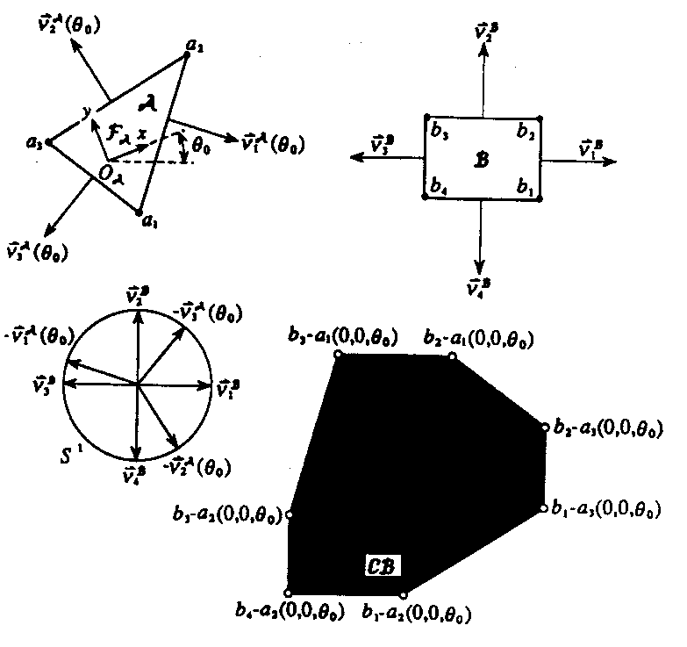
Linear-Time Computation of
C-Obstacle in 2-D
(convex polygons)

Slide 25
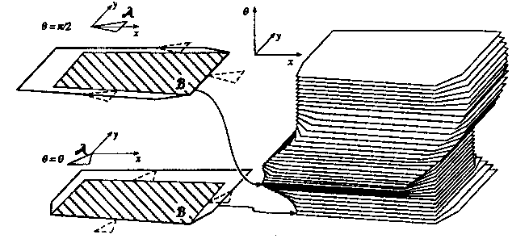
Rigid Robot Translating and Rotating in 2-D

Slide 26
C-Obstacle for Articulated Robot

Slide 27
Free and Semi-Free Paths
A free path lies entirely in the free space F
A semi-free path lies entirely in the semi-free space

Slide 28
Remark on Free-Space Topology
The robot and the obstacles are modeled as closed subsets, meaning that they contain their boundaries
One can show that the C-obstacles are closed subsets of the configuration space C as well
Consequently, the free space F is an open subset of C. Hence, each free configuration is the center of a ball of non-zero radius entirely contained in F
The semi-free space is a closed subset of C. Its boundary is a superset of the boundary of F

Slide 31
Notion of Homotopic Paths
Two paths with the same endpoints are homotopic if one can be continuously deformed into the other
R x S¹ example:
τ₁ and τ₂ are homotopic
τ₁ and τ₃ are not homotopic
In this example, infinity of homotopy classes
q
τ₂
τ₁
τ₃
q’

Slide 32
Connectedness of C-Space
C is connected if every two configurations can be connected by a path
C is simply-connected if any two paths connecting the same endpoints are homotopic
Examples: R² or R³
Otherwise C is multiply-connected
Examples: S¹ and SO(3) are multiply- connected:
- In S¹, infinity of homotopy classes
- In SO(3), only two homotopy classes

Slide 33
C-Obstacle for Articulated Robot

Slide 34
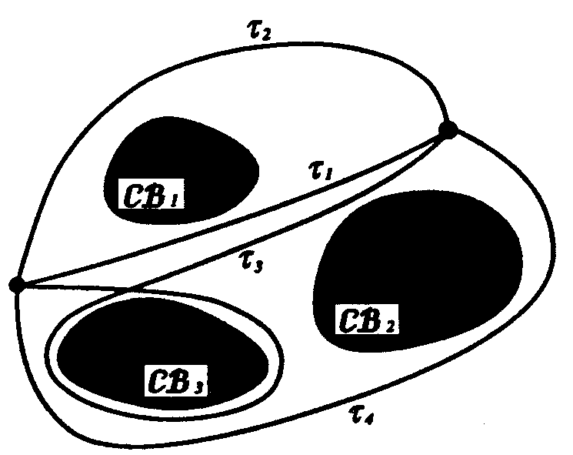
Classes of Homotopic Free Paths

Slide 35
Motion-Planning Framework
Continuous representation
(configuration space formulation)
Discretization
Graph searching
(blind, best-first, A*)

Slide 36
Path-Planning Approaches
Roadmap
Represent the connectivity of the free space by a network of 1-D curves
Cell decomposition
Decompose the free space into simple cells and represent the connectivity of the free space by the adjacency graph of these cells
Potential field
Define a function over the free space that has a global minimum at the goal configuration and follow its steepest descent

Slide 37
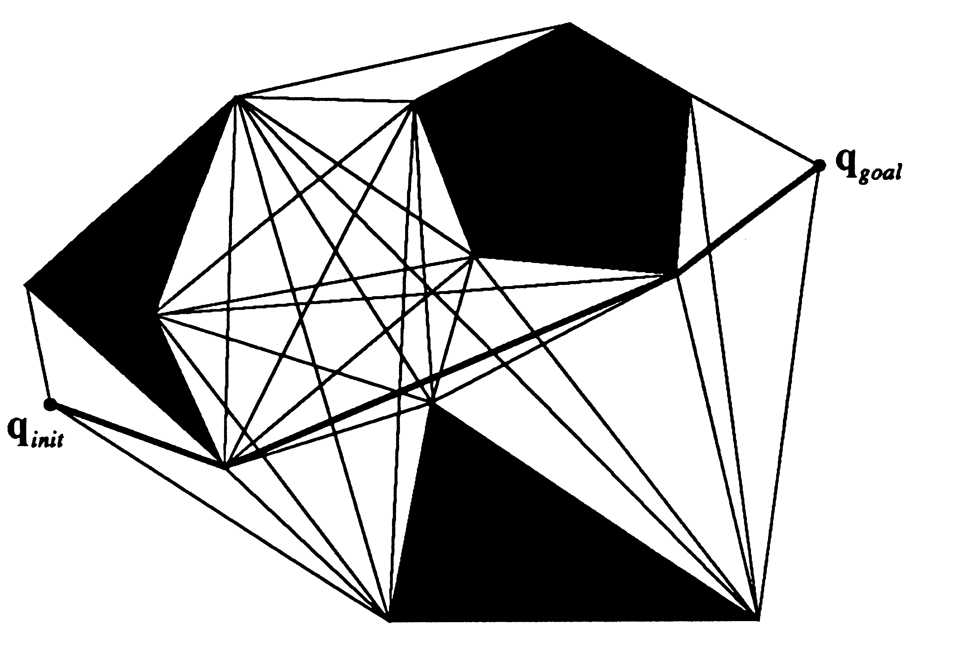
Roadmap Methods
Visibility graph
Introduced in the Shakey project at SRI in the late 60s. Can produce shortest paths in 2-D configuration spaces

Slide 38
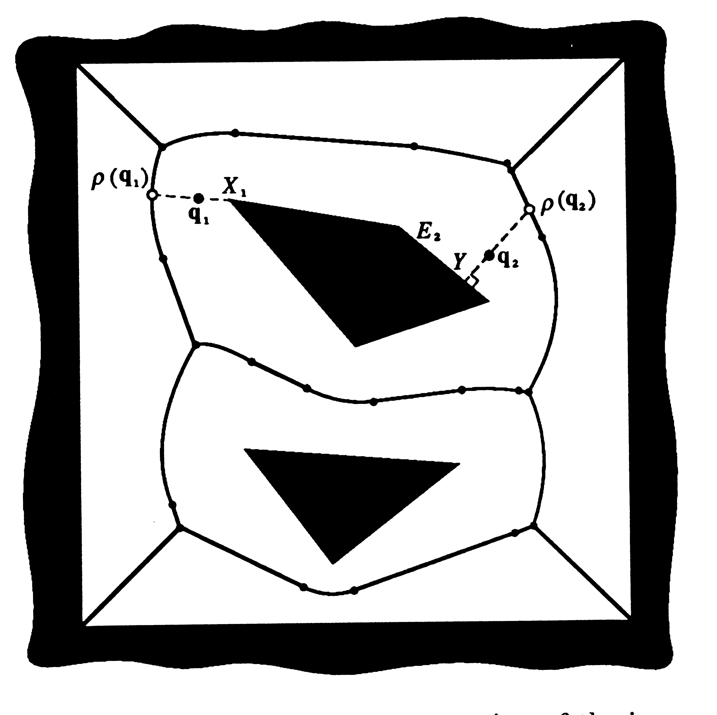
Roadmap Methods
Visibility graph
Voronoi diagram
Introduced by Computational Geometry researchers. Generate paths that maximizes clearance. Applicable mostly to 2-D configuration spaces

Slide 39
Roadmap Methods
Visibility graph
Voronoi diagram
Silhouette
First complete general method that applies to spaces of any dimension and is singly exponential in # of dimensions [Canny, 87]
Probabilistic roadmaps

Slide 40
Path-Planning Approaches
Roadmap
Represent the connectivity of the free space by a network of 1-D curves
Cell decomposition
Decompose the free space into simple cells and represent the connectivity of the free space by the adjacency graph of these cells
Potential field
Define a function over the free space that has a global minimum at the goal configuration and follow its steepest descent

Slide 41
Cell-Decomposition Methods
Two families of methods:
Exact cell decomposition
The free space F is represented by a collection of non-overlapping cells whose union is exactly F
Examples: trapezoidal and cylindrical decompositions

Slide 42
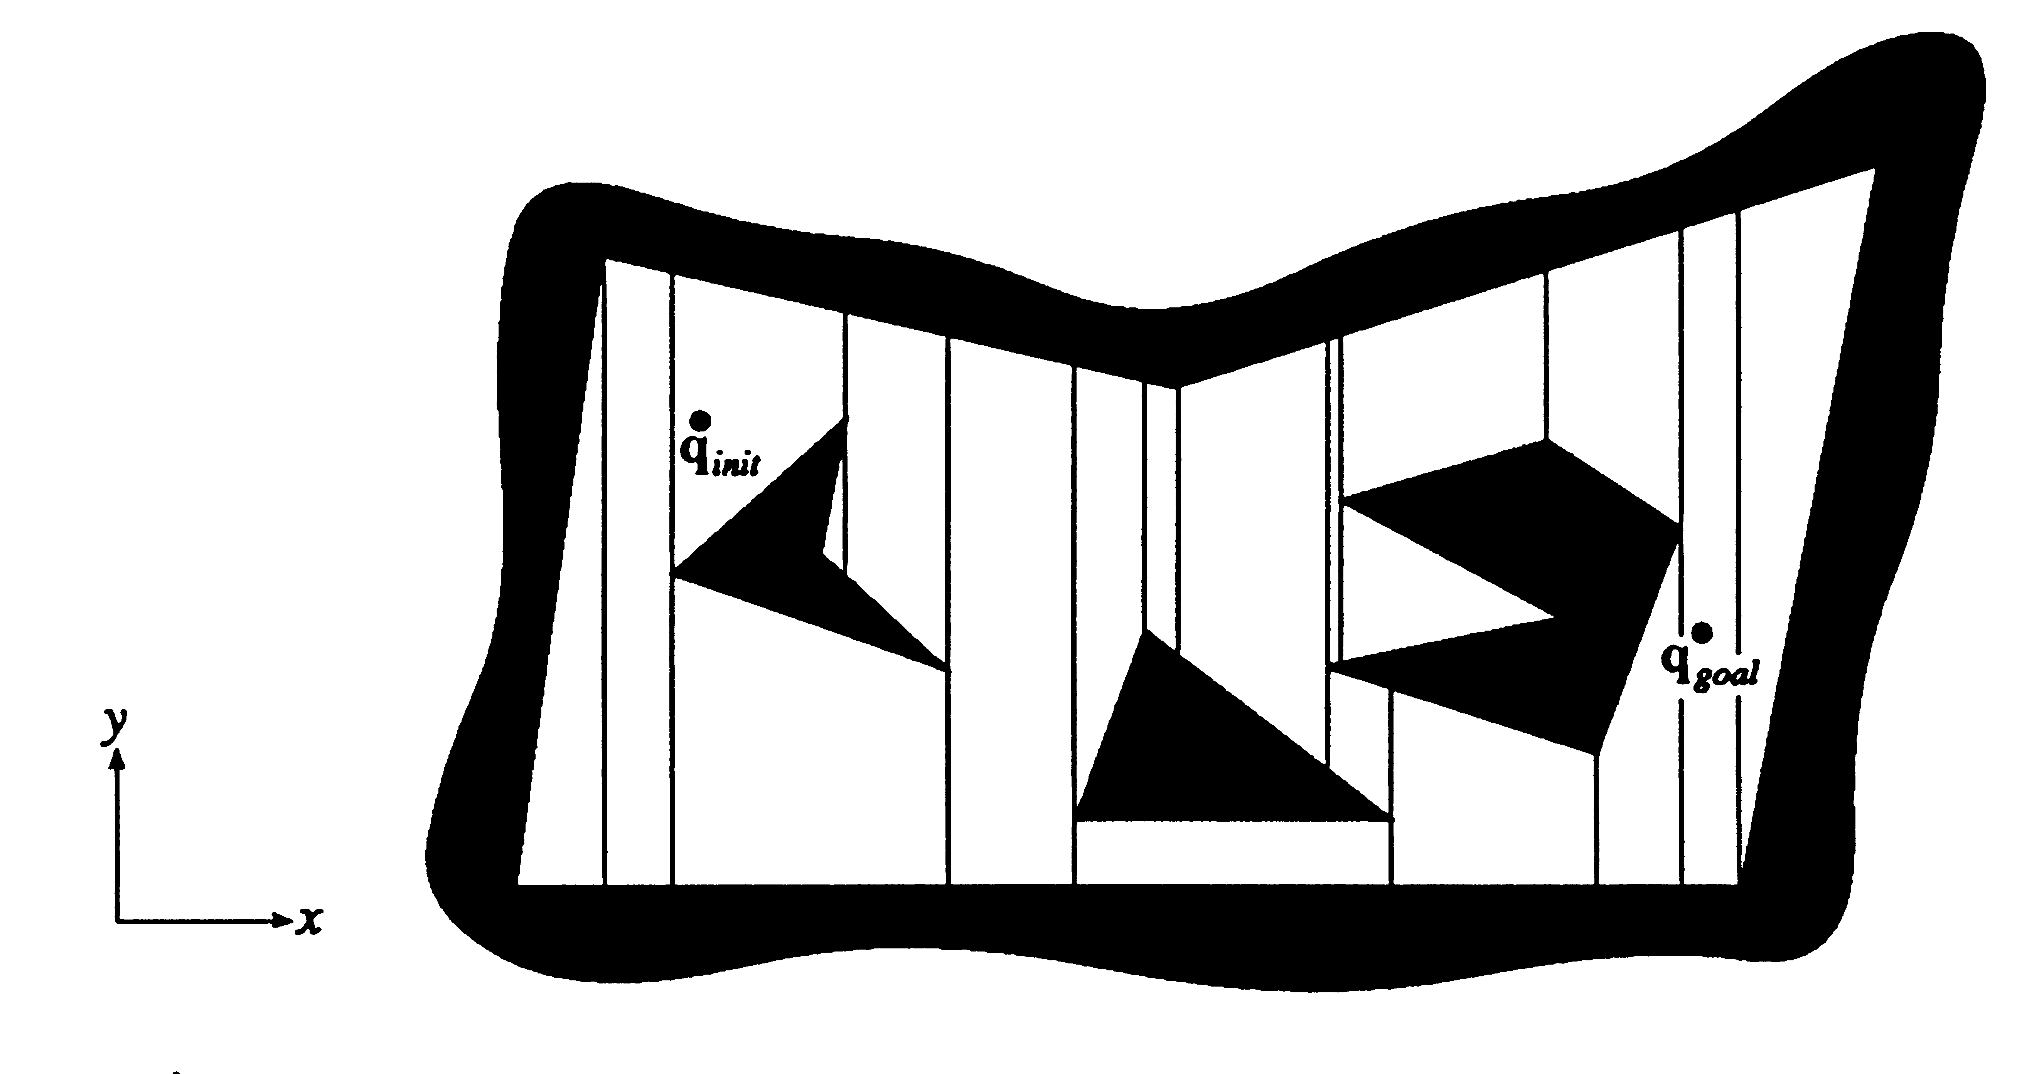
Trapezoidal decomposition

Slide 43
Cell-Decomposition Methods
Two families of methods:
Exact cell decomposition
Approximate cell decomposition
F is represented by a collection of non-overlapping cells whose union is contained in F
Examples: quadtree, octree, 2^{n}-tree

Slide 44
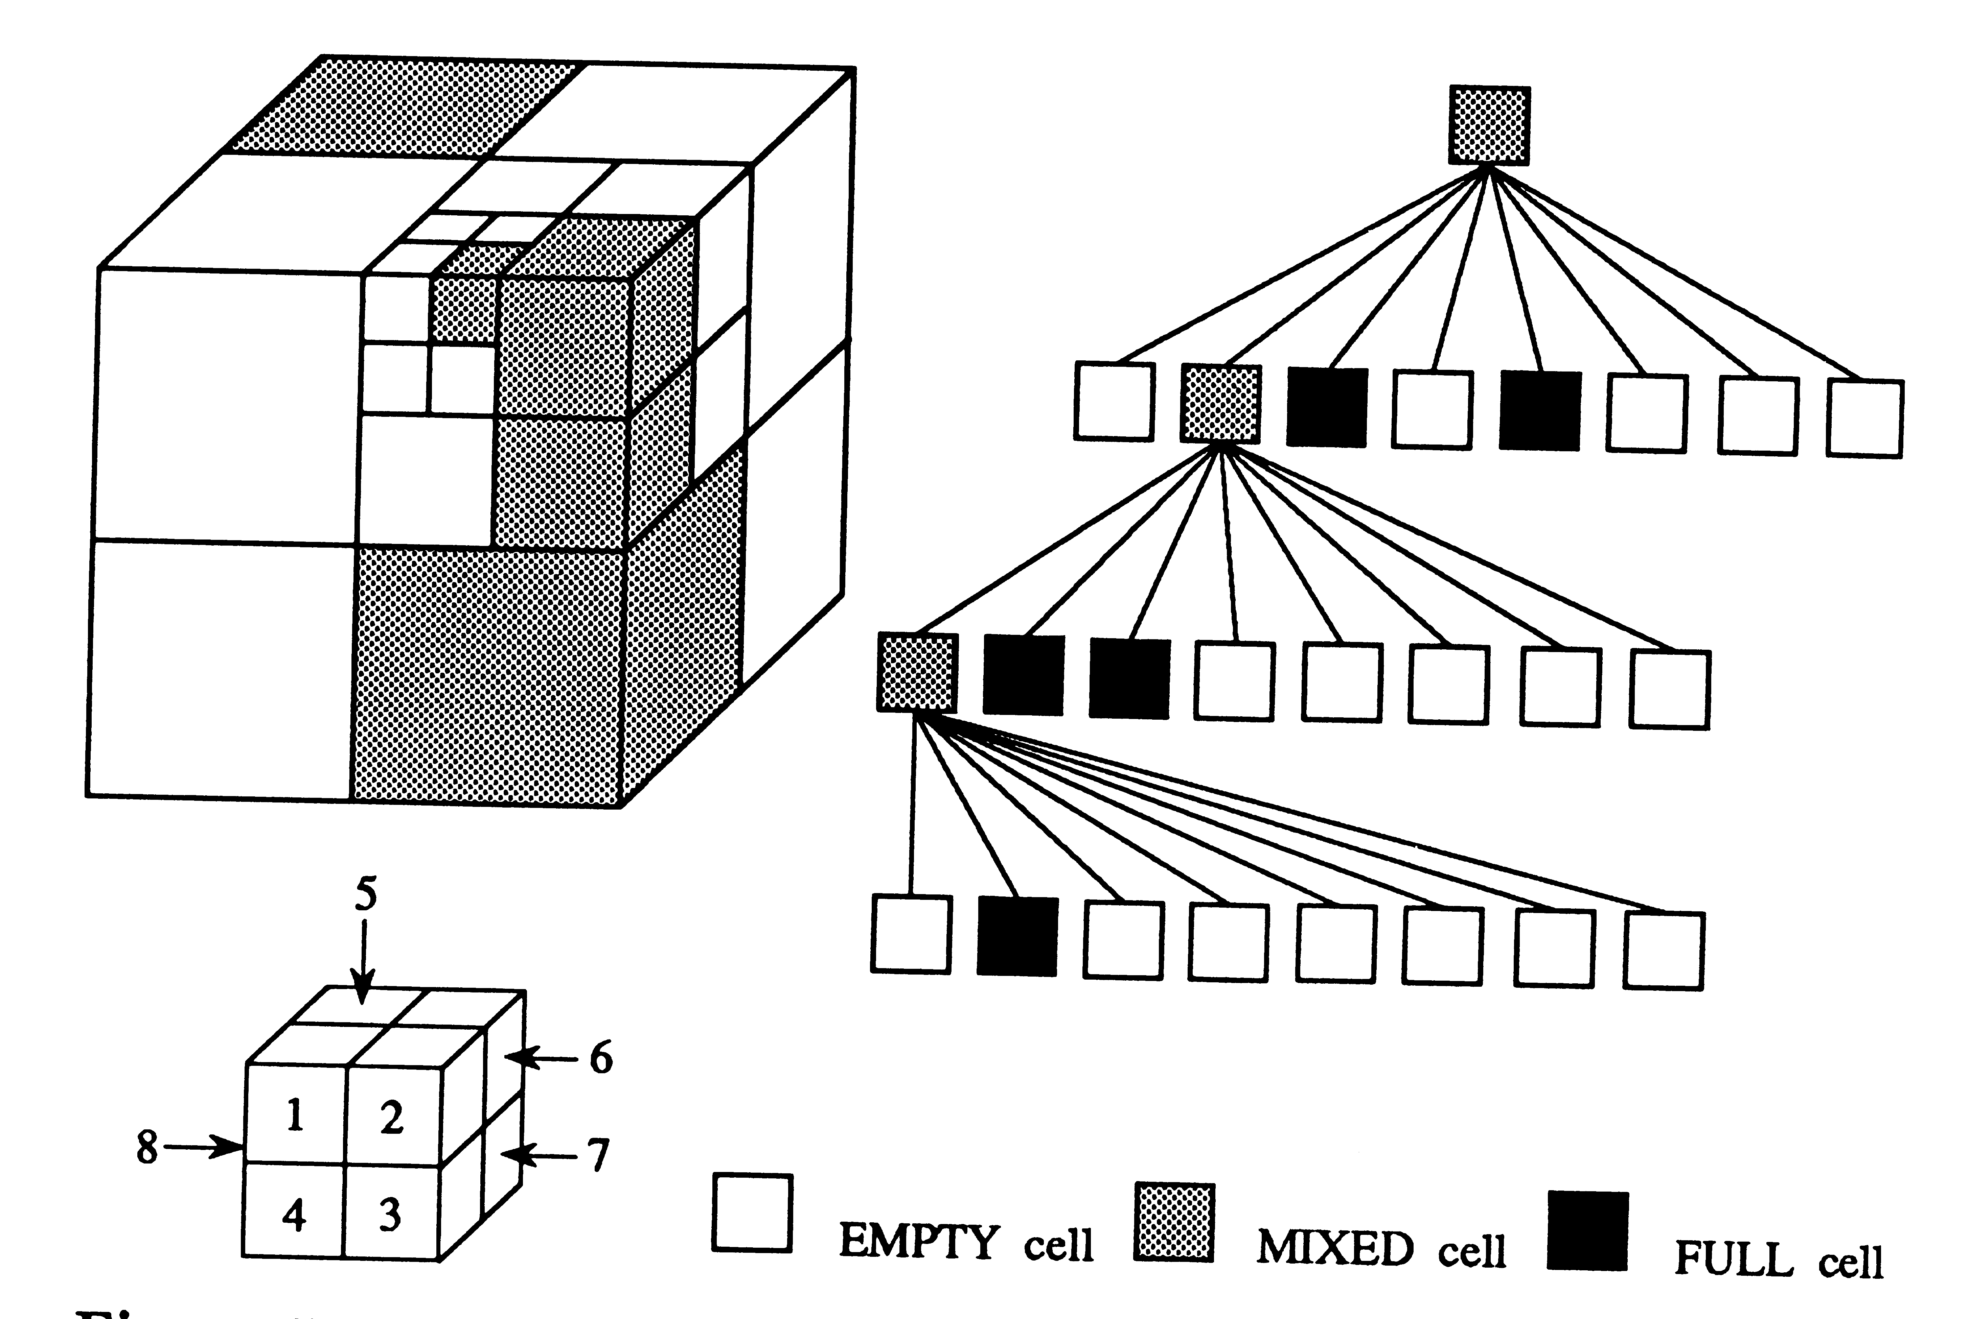
Octree Decomposition

Slide 45
Path-Planning Approaches
Roadmap
Represent the connectivity of the free space by a network of 1-D curves
Cell decomposition
Decompose the free space into simple cells and represent the connectivity of the free space by the adjacency graph of these cells
Potential field
Define a function over the free space that has a global minimum at the goal configuration and follow its steepest descent

Slide 46
Potential Field Methods
Approach initially proposed for real-time collision avoidance [Khatib, 86]. Hundreds of papers published on this topic.
Potential field: Scalar function over the free space
Ideal field (navigation function): Smooth, global minimum at the goal, no local minima, grows to infinity near obstacles
Force applied to robot: Negated gradient of the potential field. Always move along that force

Slide 47
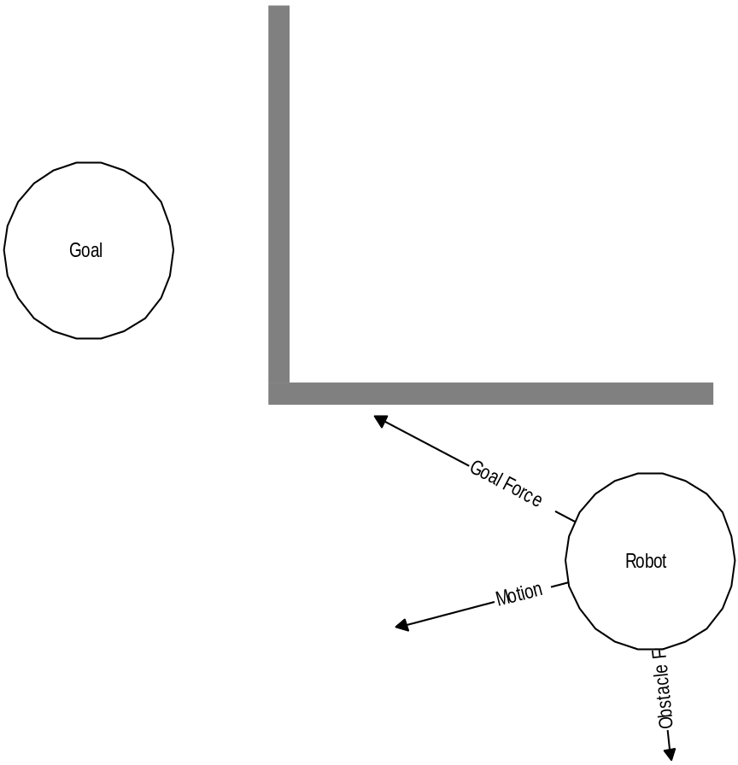
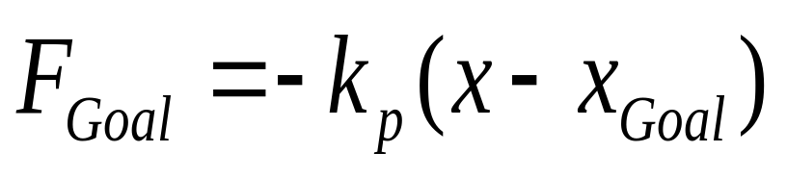
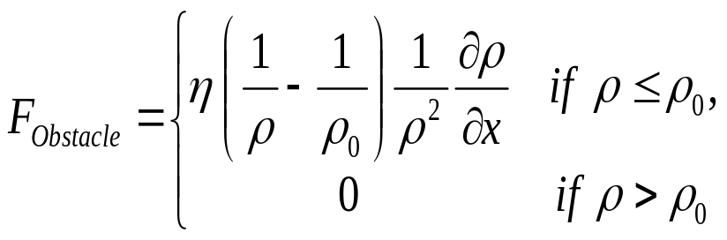
Attractive/Repulsive Fields
Khatib, 1986
Path planning:
Regular grid G is placed over C-space
G is searched using a best-first algorithm
with potential field as the heuristic function
Goal
Robot

